Slide 1
SAP BTP Extension Suite Training
Day 3
Anubhav Oberoy
www.AnubhavTrainings.com
Follow excellence with sheer passion

Slide 2


DISCLAIMER
The training content and delivery of this presentation is confidential, and cannot be recorded, or copied and distributed to any third party, without the written consent of Anubhav Trainings

Slide 3
Agenda – Day 3
01
Working with Microservices
02
Scaling
03
Basics of Node JS

Slide 4
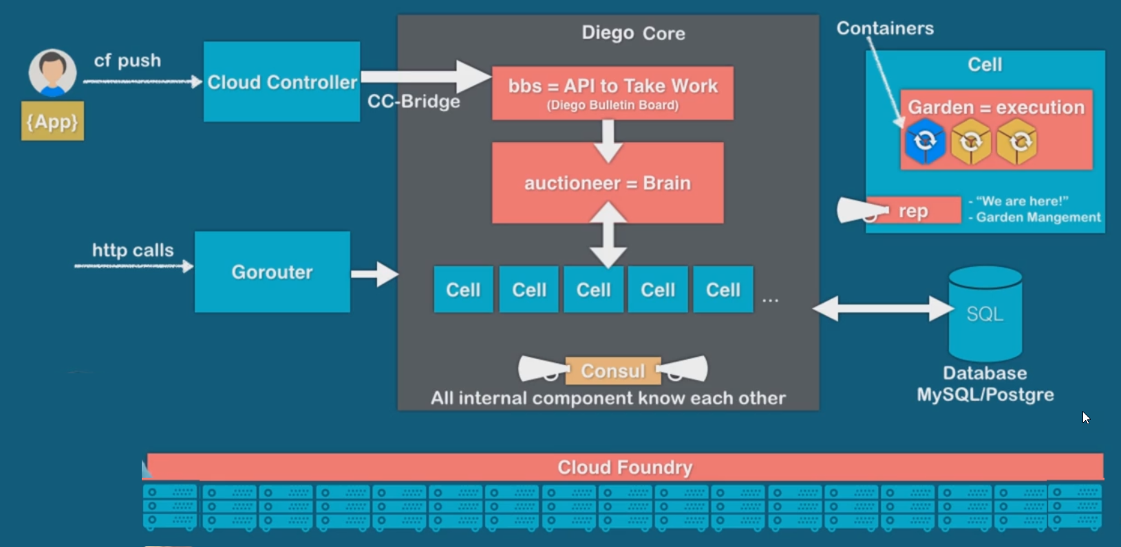
Under the hood

Slide 5

Micro Service Architecture
Characteristics of the traditional model
SAP systems are one large logical system with a single (SQL) DB
Transactional consistency for all data is guaranteed
Big, infrequent releases with high risk
Hard to apply cloud requirements
Monolith must be built, tested, deployed, and scaled as a whole
Vertical scaling* is limited, cost is non-linear
Systems often poorly utilized (dev-test, non-peak-times)
High availability setup requires almost double the infrastructure
“Microservice architecture is an approach to developing a single application as a suite of small services, each running in its own process and communicating with lightweight mechanisms, often an HTTP REST API. These services are built around business capabilities and independently deployable by fully automated deployment machinery.”

Slide 6
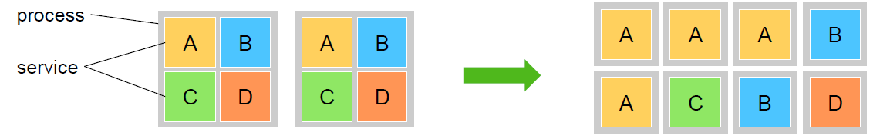
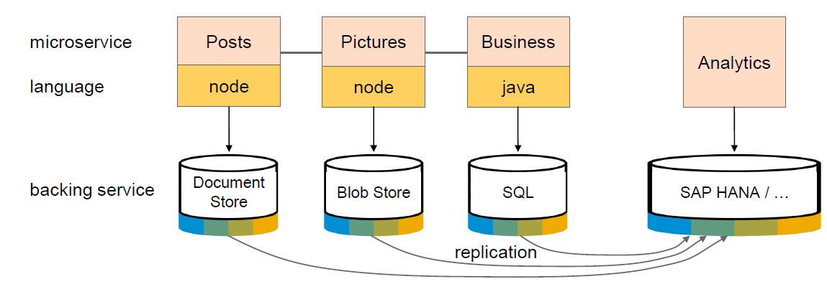
Advantage of Microservices
Each microservice runs in a separate process / container.
This enables them to
Be deployed individually and frequently
(Auto)scale independently to varying loads
You can use technologies and languages that best fit the problem *
Microservices are self-contained, i.e. no shared data stores (!)
Using the right tools impacts productivity and performance

Slide 7
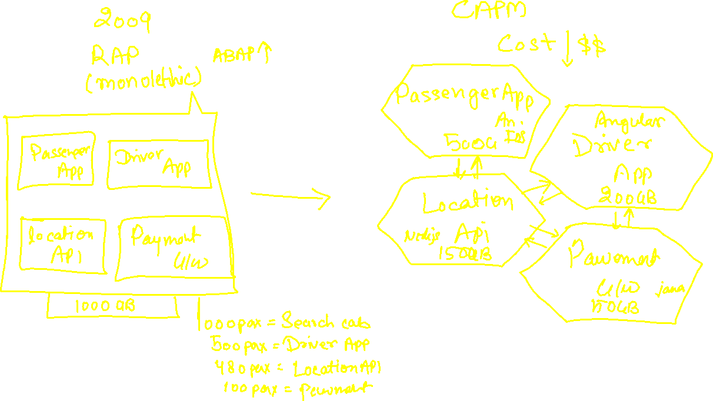
Uber

Slide 8
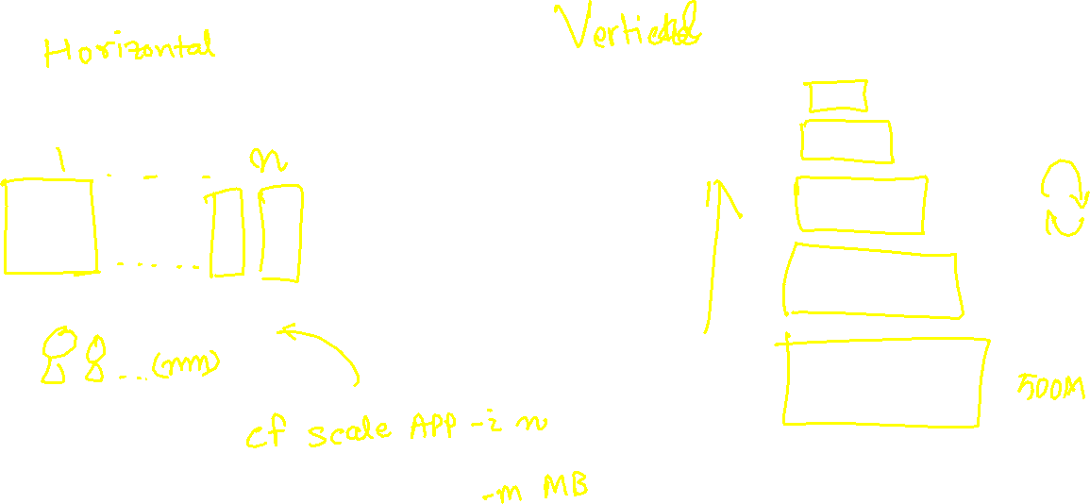
Scalability

Slide 9
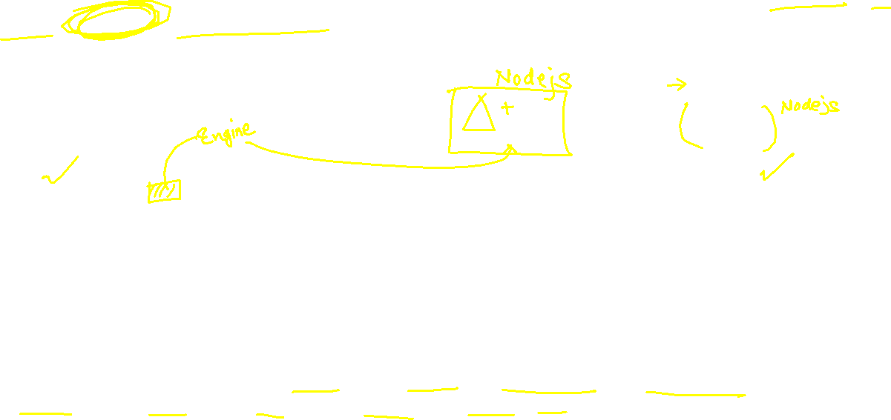
What is Node JS
Node JS is an open source, cross platform, java script runtime environment and used for executing java script code outside the web browser. Java and JavaScript are different by their nature, design and use cases. Java Script was dominantly used as a web programming language. All the browser’s directly understand java script.
Java Script
Java Script
Java
ABAP
Python
C#
Server
request
Client
Browser
port
response
Ryan Dyal
Node JS is also a great web framework for beginners because it works great with data-intensive applications like streaming, real-time apps. It is free and easy to learn node js.
Applications of node js?
Build business logic on server side, DB lookups, Send Emails, write validations, create microservices, add automations, show output, build servers, host web apps, make excel/pdf more…

Slide 10
Java Script
JS is a case-sensitive programming language e.g. iloveindia is different from iLoveIndia
Every statement in JS ends with Semi-colon
When we create a variable or function, we follow camel-case naming convention.
Iloveindia ➔ iLoveIndia wearelearningJS ➔ weAreLearningJS
If you create a variable and do not assign a value to it, it becomes NULL, any operation with NULL becomes NULL
When we create variables, we don’t need to assign data types, based on the value, the data type will be assigned automatically.
The = is an assignment operator and ==, === are comparison operator IF(a===b)
Java Script is a Asynchronous Non Blocking IO programming language

Slide 11




















Variables
Scalar Variables
Array
Objects

Slide 12




Slide 13












Slide 14
NPM – Node Package manager
It is a dependency manager tool which gets installed along with node js in our system. Just like for java we had maven, we have npm for node js.
We can find millions of reusable node modules free on internet, which helps us avoid rebuilding everything/reinvent the wheel.
We can see world’s largest reusable code repository on https://npmjs.com
If we want to install any node module
Globally - @computer level, all projects can reuse, option used to install CLI.
npm install -g module
With in the project - @localproject level, only single project can use
npm install module
When we build java project, we saw a pom.xml which contains dependencies. We have the package.json file in node project which contains details about our entire project and its dependencies. To create this we use npm init command.

Slide 15
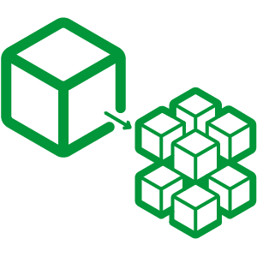

Hands on: Node JS
Solution:
https://github.com/soyuztechnologies/BTP_Architect_Training/blob/master/Day%203/02basicnode.zip
Node Microservice Solution:
https://github.com/soyuztechnologies/BTP_Architect_Training/blob/master/Day%203/03Nodemicroservice.zip

Slide 16
Variables in JS

Slide 17
Asynchronous Non Blocking IO
Application
Server

Slide 18
Functions in JS
Named Function
  Simple name
  Arrow function
Anonymous function

Slide 19
Asynchronous Non Blocking IO
Application
Server

Slide 20
NPM – Node Package manager
It is a dependency manager tool which gets installed along with node js in our system. Just like for java we had maven, we have npm for node js.
We can find millions of reusable node modules free on internet, which helps us avoid rebuilding everything/reinvent the wheel.
We can see world’s largest reusable code repository on https://npmjs.com
If we want to install any node module
Globally - @computer level, all projects can reuse, option used to install CLI.
npm install -g module
With in the project - @localproject level, only single project can use
npm install module
When we build java project, we saw a pom.xml which contains dependencies. We have the package.json file in node project which contains details about our entire project and its dependencies. To create this we use npm init command.

Slide 21
Hands on: Node JS
Solution:
https://github.com/soyuztechnologies/BTP_Architect_Training/blob/master/Day%203/02basicnode.zip
Node Microservice Solution:
https://github.com/soyuztechnologies/BTP_Architect_Training/blob/master/Day%203/03Nodemicroservice.zip

Slide 22

What We Did
Let’s Summarize

Slide 23

www.anubhavtrainings.com
Thank You
End of Day 2

Slide 24


We’re committed to empower you to be
#FutureReady
through powerful training solutions.
We build the workforce of the future.
250+
Corporate Clients
30,000+
Learners Trained
25000+
Learners Placed
FREE WEBINARS
Sign up for free webinars with industry experts every fortnight!
Enroll Now!
Contact us today!
https://anubhavtrainings.com

